Slide 1
Energy Efficiency with Smart Lighting

Slide 2
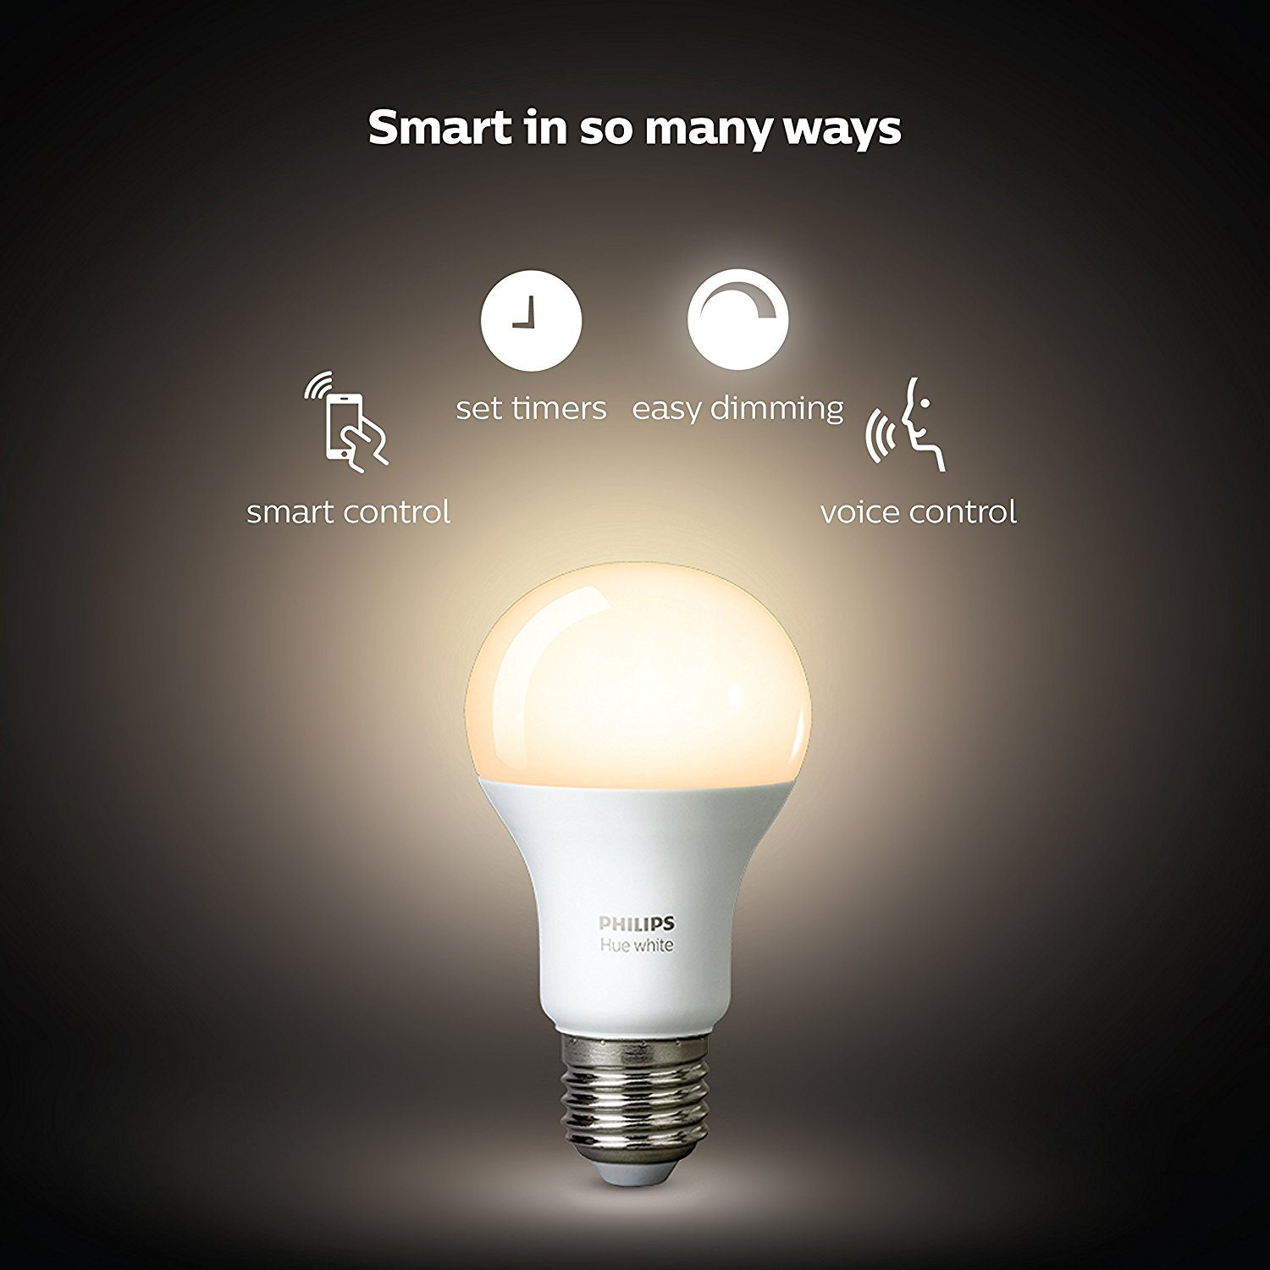
Energy Efficiency with Smart Lighting
Our school building uses a lot of electricity for lighting. Lights are often forgotten when leaving a classroom. Different rooms have different light conditions and different requirements.
Lighting and especially smart lighting can make a big contribution to a smart energy system.
Up to 30 % of the energy cost can be saved by a smart lighting solution!

Slide 3
Energy Efficiency with Smart Lighting
During the course program you will get the tools and knowledge to design smart lighting for public buildings.
Ultimately your assignment will be to design a smart lighting system for a public space.

Slide 4
Energy Efficiency with Smart Lighting
Choose a classroom in the building
Write an advice and improvement proposal for the room
How can the room be improved on :
Energy efficiency
user friendlyness
Comfort
HCL technique

Slide 5
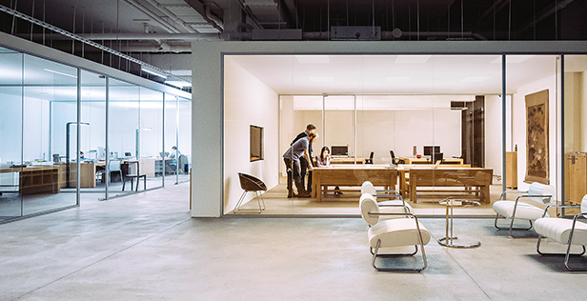
Challenge
The best proposals will be chosen and executed!

Slide 6
Go for it!

